Slide 1
Capstone Project - 2
Team 2 : Loan Default Prediction
Presented By: Shubham Kumar

Slide 2

Let’s Catch The Defaulters
Defining problem statement
EDA and feature engineering
Feature Selection
Preparing dataset for modeling
Applying Model
Model Validation and Selection

Slide 3

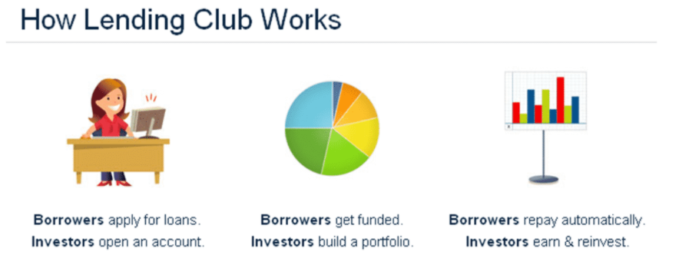
The Dilemma
Lending Club is the world’s largest online marketplace connecting borrowers and investors. An inevitable outcome of lending is default by borrowers. The idea of this project is to create a predictive model that identifies applicants who are relatively risky for a loan. In order to accomplish this, we organized the whole series into four parts as follows:

Slide 4
Data Pipeline
Data processing-1: In this first part we’ve removed unnecessary features.
Since there were nearly many columns with all null values.
Data processing-2: In this part, we manually go through each features selected from part 1, And encoded the categorical features ,changed the columns containing date time values .
EDA: In in this part, we do some exploratory data analysis (EDA) on the features selected in part-1 and 2 to see the trend.
Create a model: Finally, In this last but not the last part, we create models. Creating a model is also not an easy task. It’s also an iterative process. we show how to start with a with a simple model, then slowly add complexity for better performance.

Slide 5
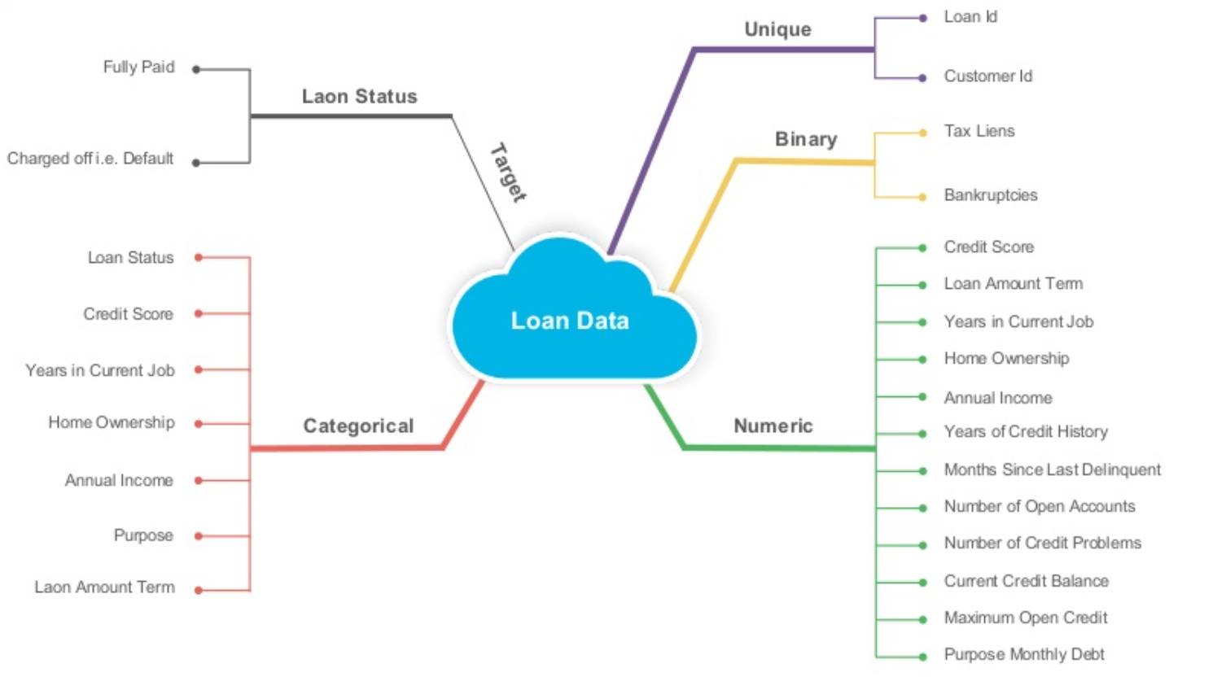
Data Summary

Slide 6
Data Summary
loan_amnt: The amount the borrower promises to repay, as set forth in the loan contract.The loan amount may exceed the original amount requested by the borrower if he or she elects to include points and other upfront costs in the loan.
Purpose:The purpose of the loan is used by the lender to make decisions on the risk and may even impact the interest rate that is offered. For example, if an applicant is refinancing a mortgage after having taken some cash out, the lender might consider that an increase in risk and increase the interest rate that is offered or add additional conditions. Loan purpose is important to the process of obtaining mortgages or business loans that are connected with specific types of business activities.

Slide 7
Data Summary
Dti: Your debt-to-income ratio is all your monthly debt payments divided by your gross monthly income. This number is one way lenders measure your ability to manage the monthly payments to repay the money you plan to borrow.
Fico_range: A FICO score is a credit score created by the Fair Isaac Corporation (FICO).¹﻿ Lenders use borrowers’ FICO scores along with other details on borrowers’ credit reports to assess credit risk and determine whether to extend credit. FICO scores take into account data in five areas to determine creditworthiness: payment history, current level of indebtedness, types of credit used, length of credit history, and new credit accounts.

Slide 8
Data Summary
Delinq_amnt : A loan is considered "delinquent" when a borrower doesn't make a loan payment on time. Most lenders allow consumers a grace period to make up a missed payment and get their loan out of delinquency. However, once a loan is delinquent for a certain period of time, it becomes at risk of going into default.
inq_last_6mths: The fundamental problem with multiple hard inquiries is that they influence lenders to form a negative impression about you credit behaviour. Too many hard inquiries over a short time-period showcase you as a credit-hungry customer with a consequently high risk-quotient.

Slide 9

Define Dependent Variable
Fully Paid->Loan has been fully paid off.
Charged off->Loan for which there is no longer a reasonable expectation of further payments.
Does not meet the credit policy. Status:Fully Paid--> While the loan was paid off, the loan application today would no longer meet the credit policy and wouldn't be approved on to the marketplace.
Does not meet the credit policy. Status:charged off->While the loan was charged off, the loan application today would no longer meet the credit policy and wouldn't be approved on to the marketplace.
Current->Loan is up to date on current payments.,
In Grace period->The loan is past due but still in the grace period of 15 days.
Late(30-120)->Loan hasn't been paid in 31 to 120 days (late on the current payment).
Late(16-30)->Loan hasn't been paid in 16 to 30 days (late on the current payment).
Default->Loan is defaulted on and no payment has been made for more than 121 days.

Slide 10
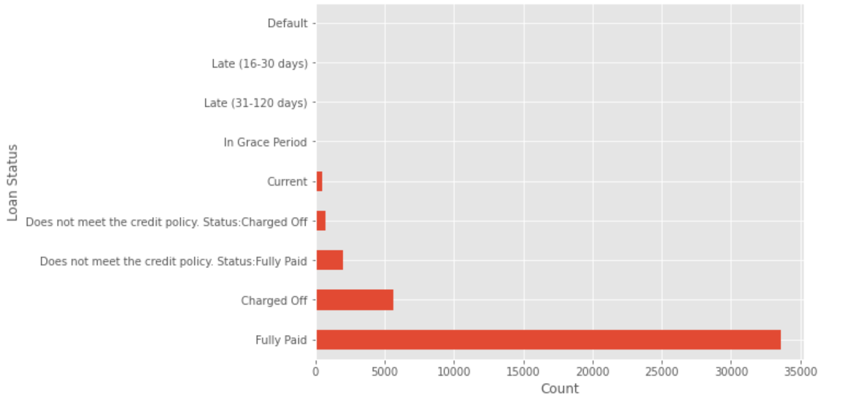
Define Dependent Variable

Slide 11
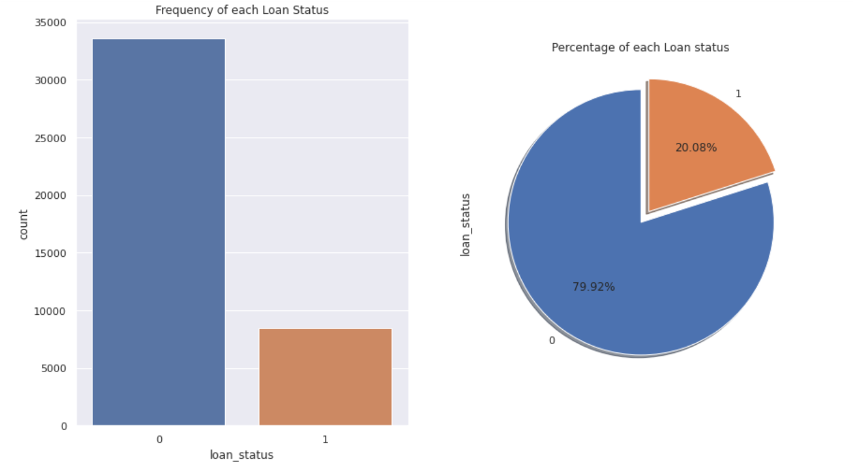
Define Dependent Variable

Slide 12
Futuristic Features
total_pymnt:- Payments received to date for total amount funded.
total_pymnt_inv:-Payments received on date for portion of total amount funded by investors.
total_rec_prncp:-Principal received to date.
total_rec_int:-Interest received to date.
total_rec_late_fee:-Late fees received to date.
recoveries:-post charge off gross recovery.
collection_recovery_fee:-post charge off collection fee.
last_pymnt_d:-Last month payment was received.
last_pymnt_amnt:-Last total payment amount received.
funded_amnt:-The total amount committed to that loan at that point in time.
funded_amnt_inv:-The total amount committed by investors for that loan at that time.

Slide 13
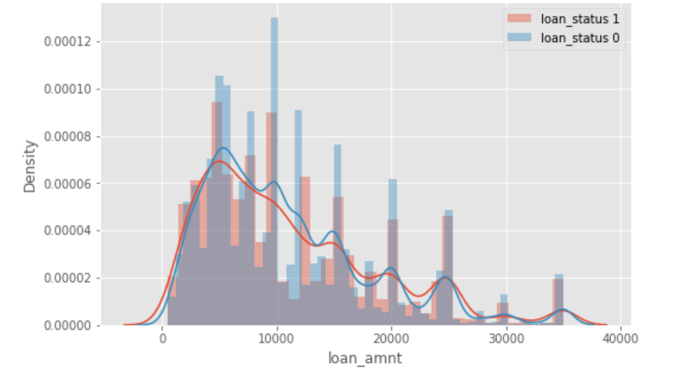
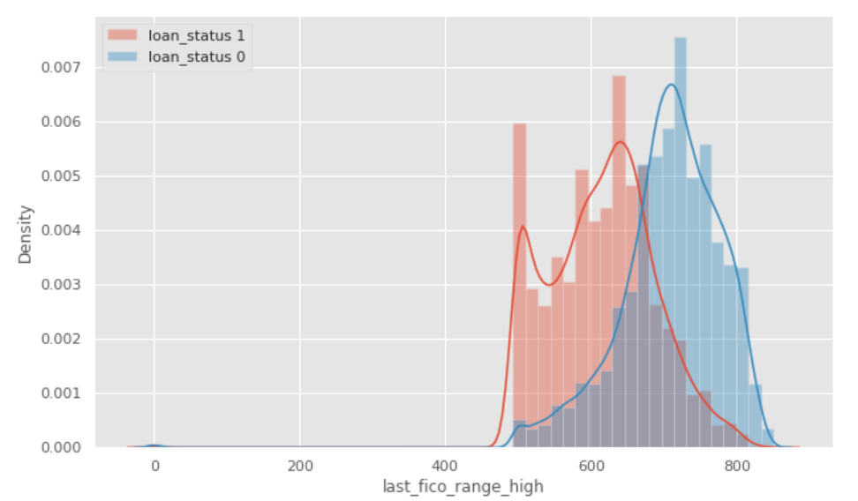
EDA

Slide 14
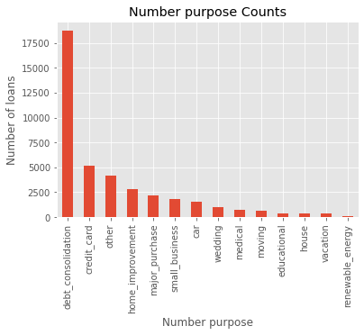
EDA (continued)

Slide 15
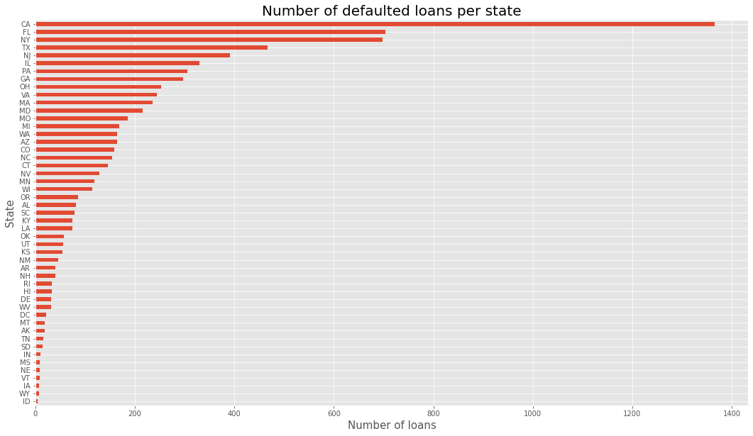

EDA (continued)

Slide 16
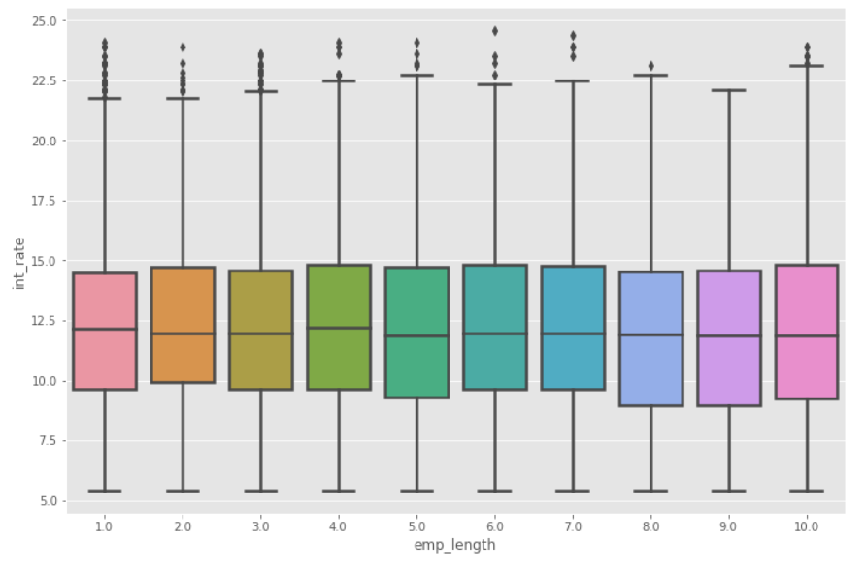
EDA (continued)

Slide 17
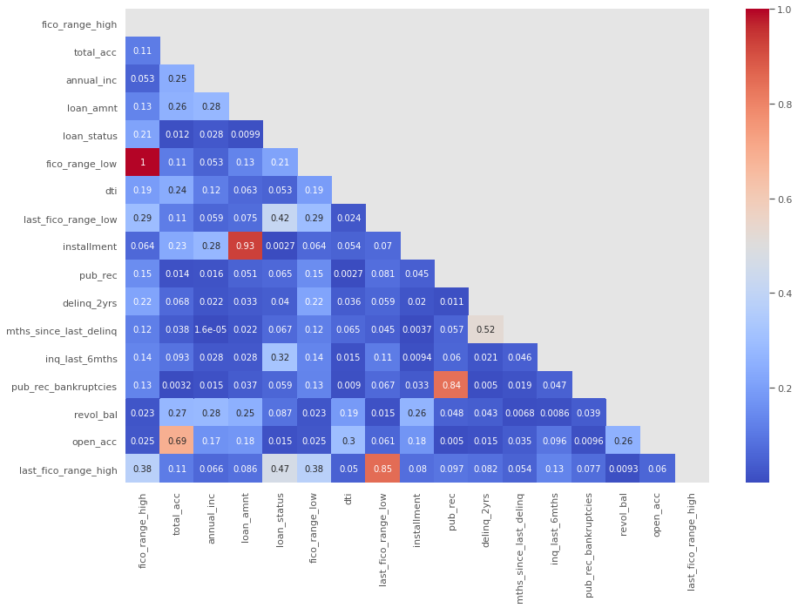
EDA (continued)

Slide 18
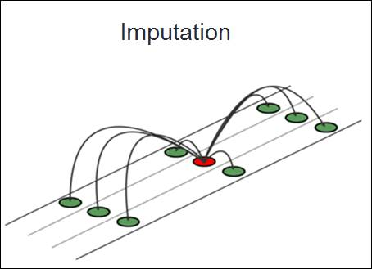
EDA (Implement KNN Imputer for missing value)
Imputation for completing missing values using
k-Nearest Neighbors.Each sample’s missing values
are imputed using the mean value from n_neighbors
nearest neighbors found in the training set. Two
samples are close if the features that
neither is missing are close.
The KNN Imputer class provides imputation
for filling in missing values using the k-Nearest
Neighbors approach. By default, a euclidean distance
metric that supports missing values,
nan_euclidean_distances, is used to find the
nearest neighbors. Each missing feature is imputed
using values from n_neighbors nearest neighbors t
hat have a value for the feature. The feature
of the neighbors are averaged uniformly or weighted
by distance to each neighbor.

Slide 19
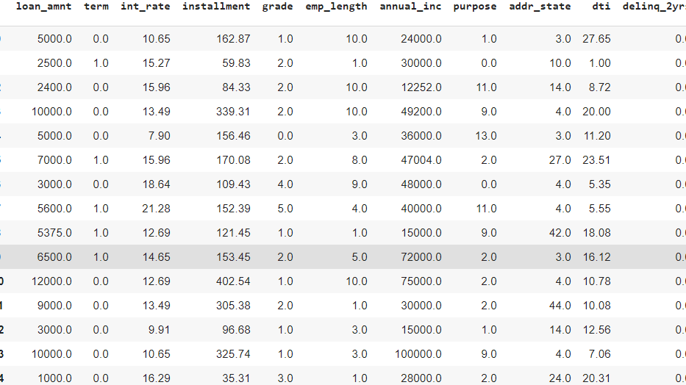
Preparing dataset for modeling
Task:-Binary Classification
Train Set:-(31516, 33)
Test set:-(10506, 33)
Response:- 0/1

Slide 20
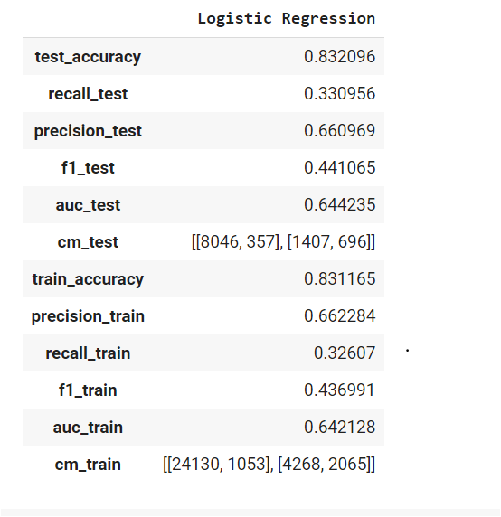
Applying Model (Baseline Model)

Slide 21
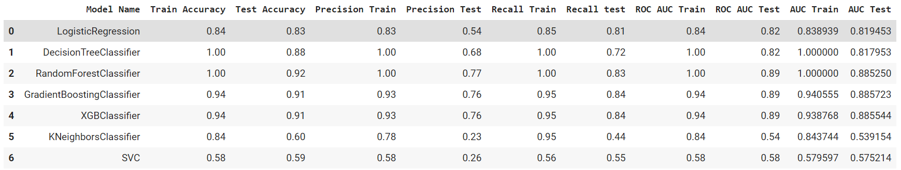
Model Validation & Selection(SMOTE)

Slide 22
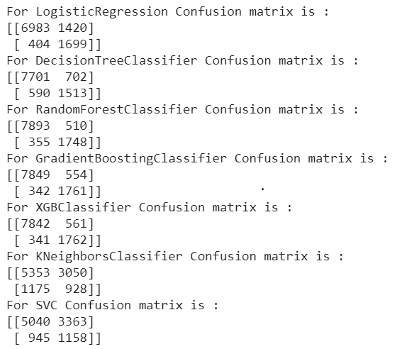
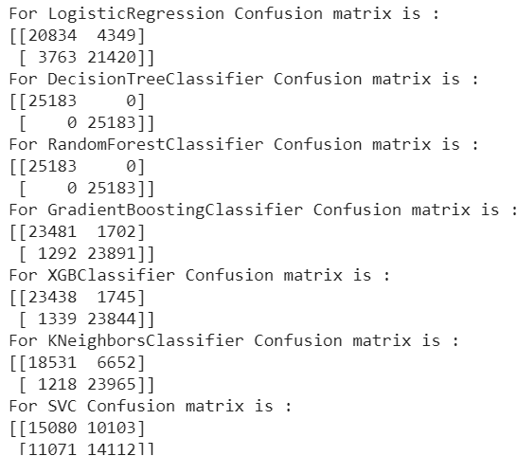
Model Validation & Selection(Classification Matrix)
Test Data
Train Data

Slide 23

Model Validation & Selection(continued)
Observation 1: As seen in the table above, Logistic Regression is not giving great results,Decision Trees are had bit better than Logistic Regression,but having lesser recall value on test data.
Observation 2:GB Classifier & XBG Classifier have performed equally good in terms of recall Score and Test accuracy.

Slide 24
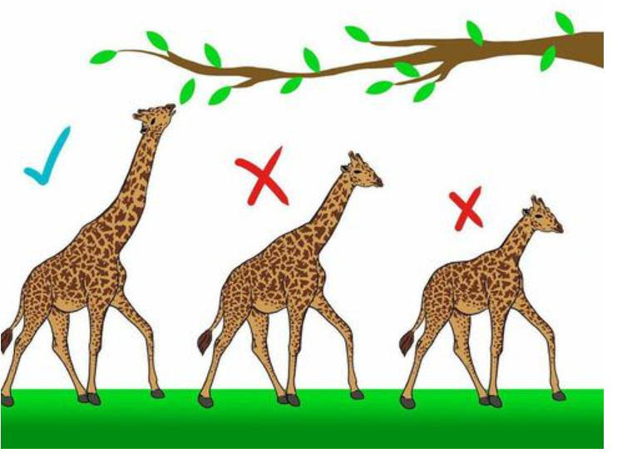
Model Validation & Selection(continued)
Observation 3: From the above observation we have come to the conclusion that we would choose our model from RF Classifier
or XGB Classifier.

Slide 25

Model Validation & Selection(continued)
We had chosen Random Forest Classifier for our
prediction and the best hyperparameters
obtained are as below.
criterion='gini'
max_depth=25
max_features='auto',
max_leaf_nodes=None
max_samples=None,
min_impurity_decrease=0.0
min_impurity_split=None,
min_samples_leaf=2
min_samples_split=10,
min_weight_fraction_leaf=0.0
n_estimators=800

Slide 26

Model Validation & Selection(continued)
We had chosen XG Boost Classifier for our prediction and the best hyperparameters obtained are as below.
Best hyperparameters:
colsample_bylevel=1,
colsample_bynode=1
colsample_bytree=0.9,eta=0.3,gamma=0,
learning_rate=0.1, max_delta_step=0, max_depth=5,
min_child_weight=1, missing=None, n_estimators=100, n_jobs=1,nthread=4,num_boost_round=10
objective='binary:logistic'
random_state=0, reg_alpha=0, reg_lambda=1,scale_pos_weight=90

Slide 27
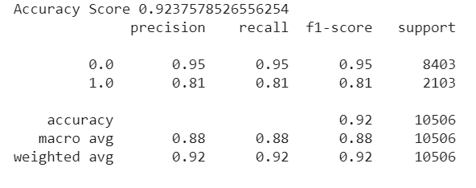
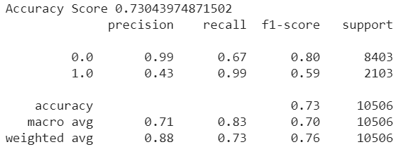
Model Validation & Selection(Hyperparameter tuned)
Random Forest Classifier
XG Boost Classifier

Slide 28
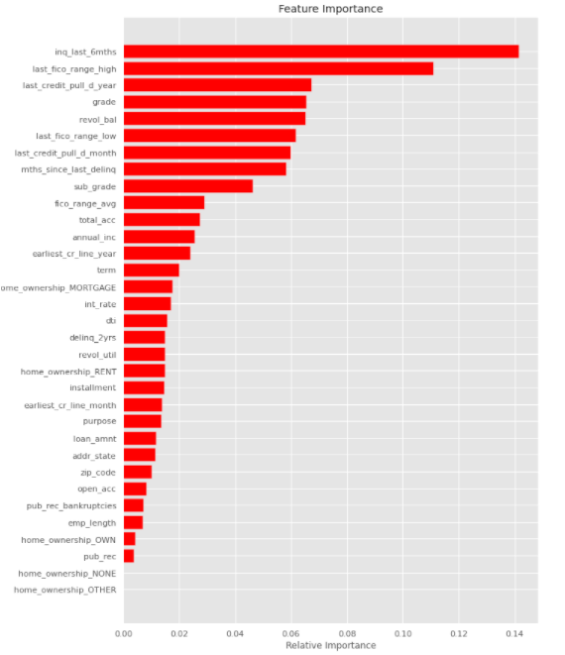
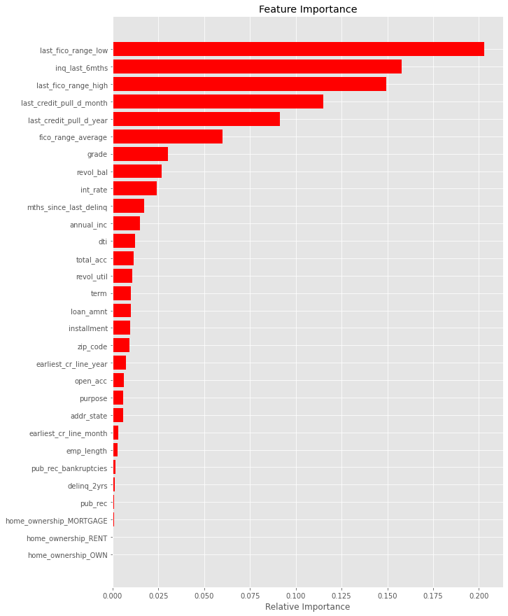
Model Validation & Selection(Feature Importance)
XG Boost Classifier
Random Forest Classifier

Slide 29
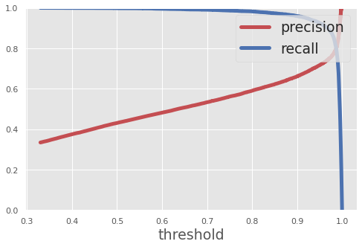
Model Validation & Selection
Random Forest Classifier
Precision vs Recall
XG Boost Classifier(scale_pos_weight)

Slide 30
Conclusion
The last_fico_range, grade, inq_last_6month features were found to be the most relevant for predicting loan default in. The current model tries to predict default biased data from credit analysts grade and assigned interest rate. . The XGB and Rf models provide substantial improvements on traditional credit screening. A recall score significantly and robustly above 90%, with AUC-ROC scores ≃74%. The features provided to the model in our study generalize to any lending activity and institution, beyond P2P lending. The present work could, therefore, be augmented in order to predict loan default risk without the need for human credit screening.
Only the Random Forest., XGBoost, model is used, but there are many good ones out there even neural networks. The models can also be improved further by finer tunings on hyperparameter.
In the bank loan behaviour prediction, for example, banks want to control the loss to a acceptable level, so they may use a relatively low threshold. This means more customers will be grouped as “potential bad customers” and their profiles will be checked carefully later by the credit risk management team. In this way, banks can detect the default behaviours in the earlier stage and conduct the corresponding actions to reduce the possible loss.

Slide 31
Challenges
Huge chunk of data was to be handled keeping in mind not to miss anything which is even of little relevance.
Feature selection was quite a challenge as our dataset had many futuristic features which had no relevance for initial detection of loan defaulter.
Computation time.

Slide 32
Q & A

